Slide 1
Hitler's Rise to Power
An overview of the causes of Hitler’s rise to power in Germany.

Slide 2
Introduction
The National Socialist German Workers Party (NSDAP) or Nazi Party was formed in 1919
Hitler joined the party shortly after it’s inception – became leader in 1921
Hitler created the 25 point plan (Party manifesto)
Hitler formed the SA (Brownshirts)
Hitler designed the Swastika flag

Slide 3
Nazi Beliefs
Rearm Germany and retake what was lost at Versailles
The German Race “master race” (blonde, blue eyed Aryans) were the superior race. Anyone else was racially impure (Jews, gypsies, communists) and should be removed from Germany.
The “master race” needed more living space, known (in German) as Lebensraum

Slide 4
Germany 1919-1923
Many Germans were disillusioned after the defeat in the First World war. Ex-soldiers felt that they had been ‘Stabbed in the back’
Right Wing groups gained popularity by saying that they would destroy the Treaty of Versailles

Slide 5
How did the Nazi party gain support in this period?
Military uniforms demonstrated strength at a time when the government was weak
Use of force against Communists and Trade Unionists was popular with businesses
Populist policies and rhetoric were employed to discredit opponents and win support.
References to traditional values and reminders of ‘who was to blame’ for the economic crisis builds support.

Slide 6
1923: Munich Putsch violent uprising
By 1923 the Nazi party had gained much support in Bavaria (SE Germany)
Adolf Hitler and Nazi’s attempted to seize control of the government through use of force
Despite having many sympathisers the putsch fails and Hitler is imprisoned for 9 months
The Nazi’s underestimated their power and the failure demonstrates that power can only be achieved through legal means i.e. through elections

Slide 7
Regrouping
Whilst in prison Hitler analyses the party’s strategy. Writes Mein Kampf (My Struggle)
Political strategies are developed and refined
There’s a shift to winning electoral support
Development of propaganda
Attempts to win support of big business
Creation the SS as Hitler’s personal bodyguard

Slide 8
Most importantly Hitler changes the Nazi party from a revolutionary group to a political party seeking peoples votes

Slide 9
1924-1929
A focus on traditional values
Building up fear of Left Wing groups
Continued use of military imagery
But … there was a lack of electoral support due to the relative prosperity in Germany at the time (Stresemann period)

Slide 10
1929-1932 - A Change in Fortunes
Wall Street Crash leads to the end of effective financial assistance from USA (Dawes & Young Plans)
Unemployment rises rapidly
Hyperinflation recurs …fears of a return to 1923
Threat of Communism increases
Coalition government fails to address problems successfully

Slide 11
Into Government
By 1932 the Nazi’s become largest single party in the Reichstag (German Parliament)
President Hindenburg becomes increasingly reliant upon Article 48 (President take emergency measures without Parliament consent)
Germany in desperate need of a strong leader (Hitler ?)

Slide 12
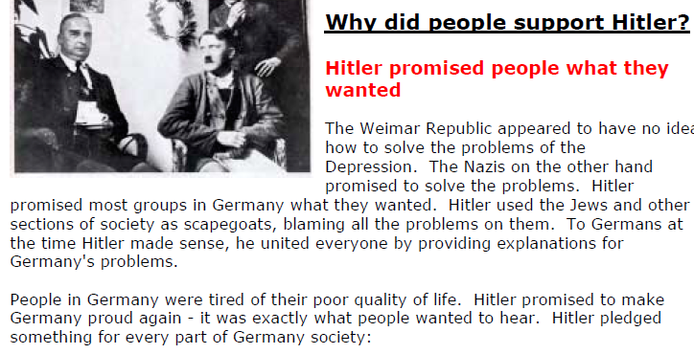

Slide 13
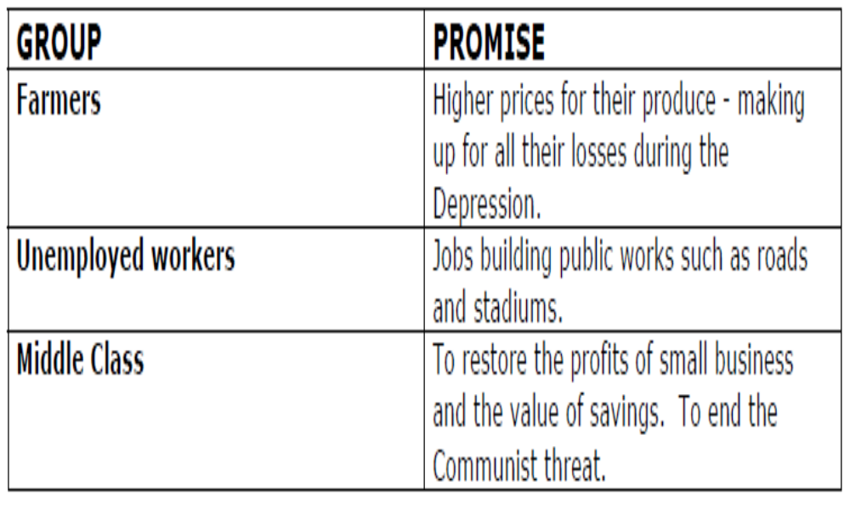
Hitler’s Promises to the German People

Slide 14
Appointed Chancellor
In January 1933 Hitler is appointed Chancellor
Nazi’s though didn’t have a 2/3 majority in the Reichstag to pass laws

Slide 15
Reichstag Fire 1933
German Parliament set alight
Hitler blamed it on communists – wanted to take over Germany
‘Reichstag Law’ passed
  Imprison communist leaders.
  Ban communists from elections.
  Media control to gag newspapers and radio.

Slide 16
Enabling Law March 1933
1933 elections best ever result for Hitler and Nazi’s
Still though didn’t have 2/3 majority
‘Enabling Law’ passed
  Ban ALL other political parties and make a ONE PARTY STATE.
  Break up the TRADE UNIONS.
  Put Nazis into local /state government.
Hitler said it would be temporary

Slide 17
Night of the Long Knives, June 1934
Why did Hitler destroy his own SA?
  It was large and lacked discipline (over 2.5 million members)
  SA leaders did not want or have the support of big business
Leaders of the SA were executed and the rest merged into the army
Notes:
On 24th June 1934 Hitler acted. He called a meeting of SA leaders for the following day at the Wiesse in Bavaria. Hitler wanted the SA to almagamate with the SA.
Generals put pressure on Hitler to discipline the SA.

Slide 18
Fuhrer
President Hindenburg dies in August 1934
Hitler immediately merged the titles of Chancellor and President
The army was made to swear an oath of loyalty to him
He had total control of his own party, the army, media and the political process
Rise to the top was complete – becomes Fuhrer (Absolute Leader)

